Slide 1
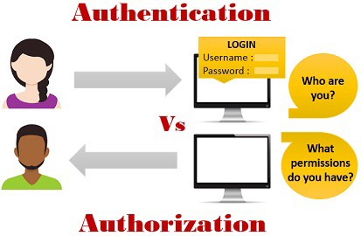
Authentication vs Authorization
The Authentication is the process or action of verifying the identity of a user.
The authorization is the process of providing or granting permissions to a user to access a protected resource.

Slide 2
Authentication vs Authorization
What is Authentication?
Simple English Meaning: The process or action of verifying the identity of a user.
Authentication is the process of proving one’s identity before trying to gain access to a resource. We see Authentication everywhere in our day to day lives such as:
Passports
ID Cards
Aadhaar Cards
In Tech World, we see Authentication in the following scenarios:
Website LogIns
Mobile Phone LogIns
Computer LogIns
Generally, Authenticating yourself is just proving to the system that you are the one you are claiming to be. It normally takes place in the following way:
A user tries to Log In to the system and is asked to present his username and password. When both of these things are entered and are validated as true by the system, the user is authenticated and is allowed to Log In.

Slide 3
Authentication vs Authorization
Types of Authentication
Single-Factor Authentication: It is the simplest form of Authentication and requires just a username and password. Once these two are validated, a user is allowed to log in. Example: Simple website login
Two-Factor Authentication: This form of Authentication requires an additional piece of information that only the user knows, along with the username and password. Example: Logging In a website with the username and password, along with an OTP (One-Time Password) which is sent to the user’s email id or phone.
Multi-Factor Authentication: This is the most advanced method of Authentication which requires two or more levels of security from independent categories of authentication to grant a user access to the system. This form of authentication utilizes factors that are independent of each other in order to eliminate any data exposure.

Slide 4
Authentication vs Authorization
Authorization
Simple English Meaning: Official permission for something to happen, or the act of giving someone official permission for something.
The authorization is the process of providing or granting permissions to a user to access a protected resource.
Some examples of Authorization are:
Granting individual access to a specific location in a building
Allowing a user to access specific parts of a website

Slide 5
Authentication vs Authorization
Authentication and Authorization working Together in Real World
In offices, when a new employee joins, he is given two things-
ID card (Authentication)
Access Card (Authorization)
The use of the ID Card is to prove the employee’s identity. It contains the name, employee ID and some other details of the employee.
The use of the Access Card is to grant special permissions to an employee to access specific parts of the office. For example, some employees might not have permission to access the server room and some employees might have. The Access Card helps in establishing the relationship between a user and the scope of access he has.

